Slide 1
MSSP 608: Practical Machine Learning Methods Week 12
1

Slide 2
House Keeping
Assignment 4 will be returned by tomorrow.
Assignment 5 due Friday, 4/22 at 11:59 PM EST
PLEASE TURN IN GOOGLE COLAB LINK (Google Colab)
Assignment 5 hints are embedded within the assignment
Quiz due tomorrow at 11:59 p.m. EST
Final project Google Colab posted; due 4/29 at 11:59 p.m. EST

Slide 3
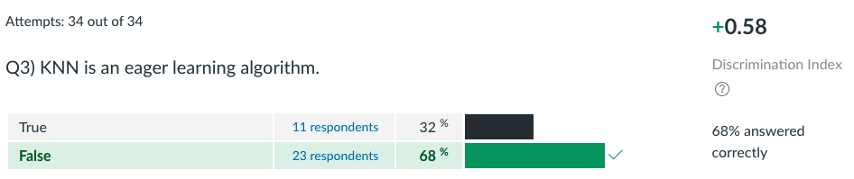
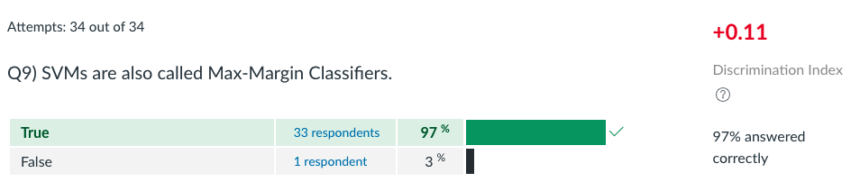
Quiz 7

Slide 4
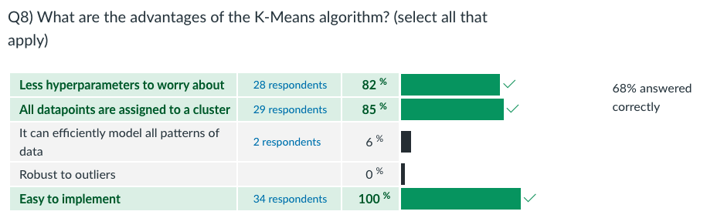
Quiz 8

Slide 5
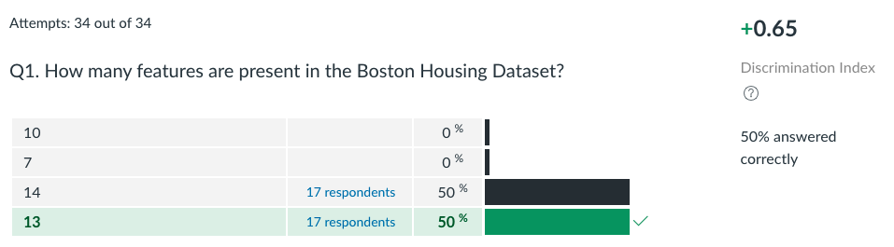
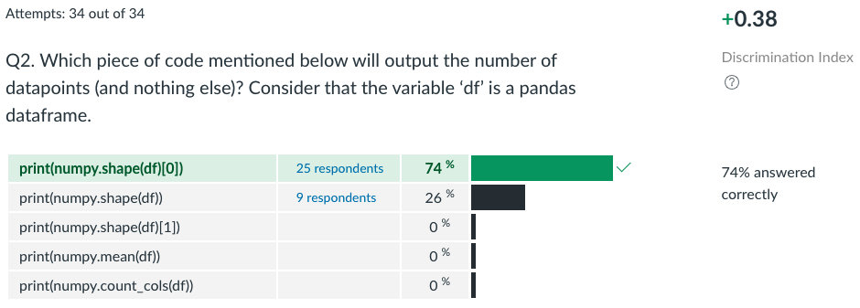
Quiz 9 (1)

Slide 6
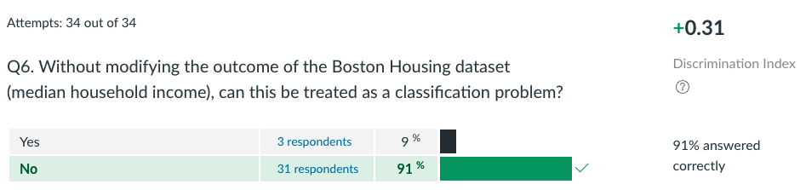
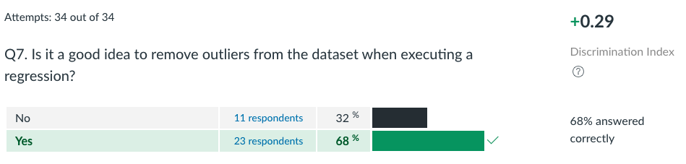
Quiz 9 (2)

Slide 7
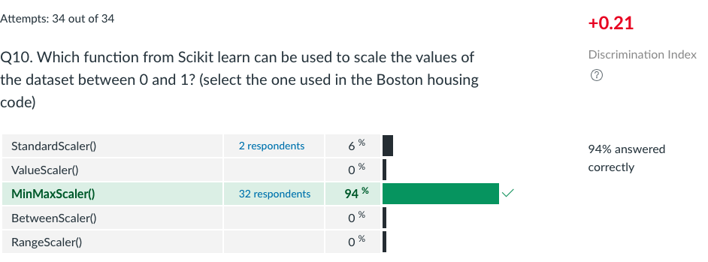
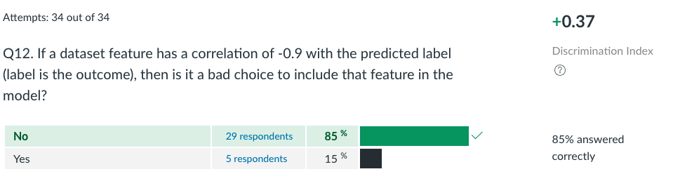
Quiz 9 (3)

Slide 8
Road Map…
Validation | ML Algorithms
 | Supervised | Unsupervised | Other
 | Decision trees | Prin. Comp. Anal. (PCA) | Data exploration
Test/train (hold out cross validation) | Linear regression | K-means | Algorithmic Fairness
K-fold cross-validation | Logistic regression |  | Text analysis (NLP) – part 1
Stratified cross-validation | Random Forests (bagging method) |  | Text analysis (NLP) – part 2
Hyperparameter tuning (ridge, lasso, elastic net regression) | Support vector machines (SVM) |  | Text analysis (NLP part 3) (Vote on topic)
Ensemble learning | K-nearest neighbors (knn)
Bagging
Boosting

Slide 9
Next 3 weeks
Week 12:
NLP part 2
Week 13:
Bayes theorem applications (spam email)
Multilingual NLP (Chinese)
Week 14 (April 25th and 27th):
Sign up for 20-minute blocks to discuss group project

Slide 10
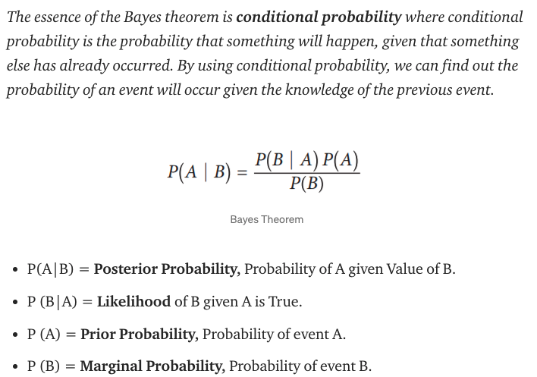
Bayes Theorem:

Slide 11
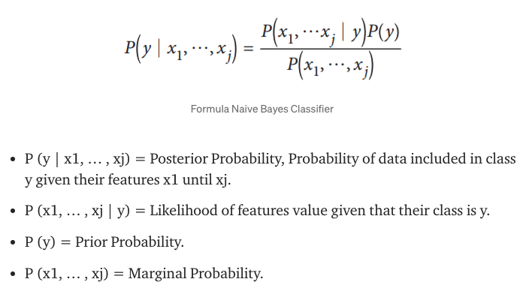
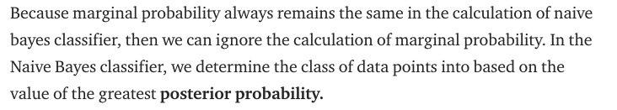
Bayes Theorem again…

Slide 12
We learned 3 NLP Methods last week
Method 1: Basic approach
Method 2: Lexicon-based approach
Method 3: Bag of words + Naïve Bayes
Method 4: Part-of-Speech Training
Method 5: Dependency Parsing
Method 6: Embedding Vectors

